Slide 1

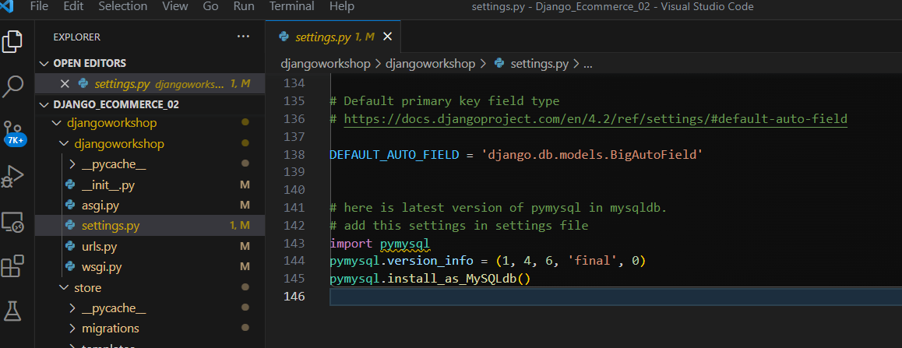
The Project run on Dell notebook
Database name is Chaison
Problem can not see

Slide 2
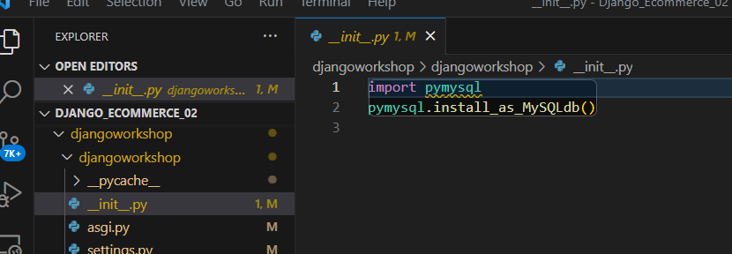

Slide 3
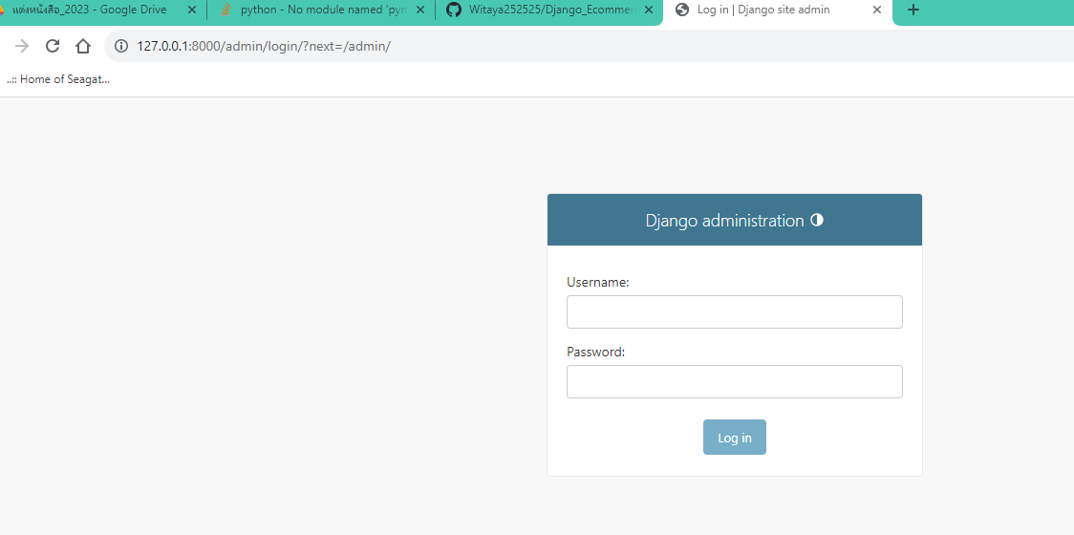
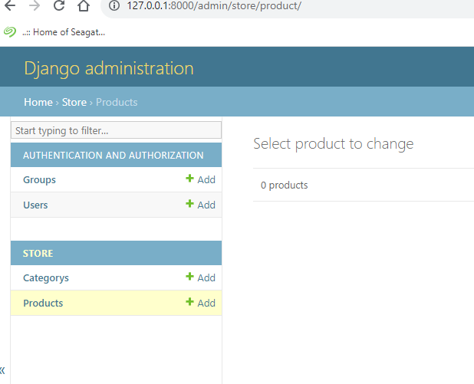
Witaya
339073

Slide 4
